Slide 1



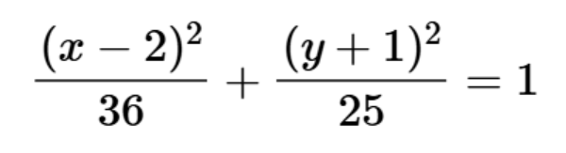
PROBLEM STATEMENT
Tasks:
Draw the ellipse.
Fill with cyan using flood-fill.
Shear and fill transformed ellipse with green.
Implement anti-aliasing.

Slide 2

MATHEMATICAL FOUNDATION
STANDARD ELLIPSE EQUATION
Center (h,k): (2, -1)
Semi-major axis (a): 6
Semi-minor axis (b): 5
Parametric Form:

Slide 3
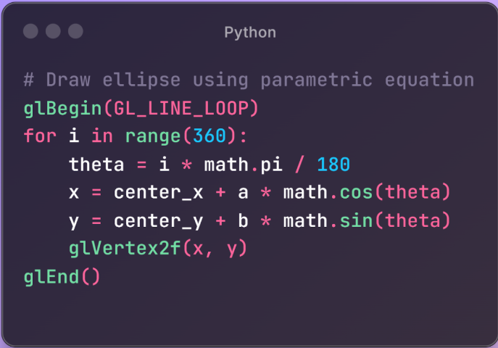
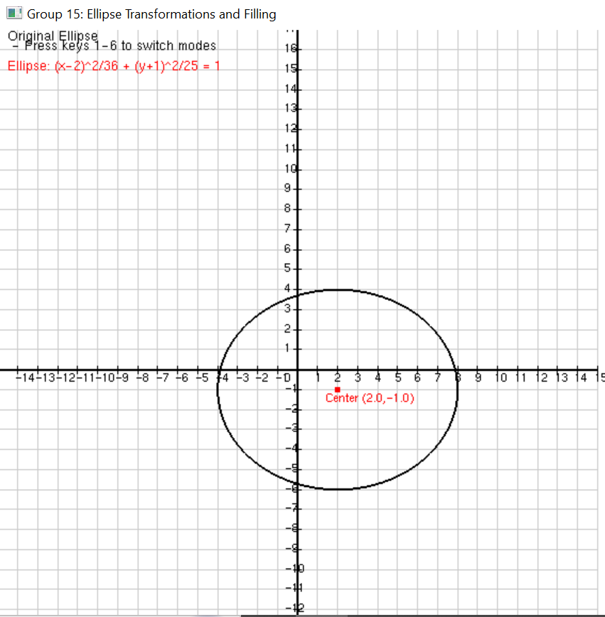
CODE AND OUTPUT

Slide 4
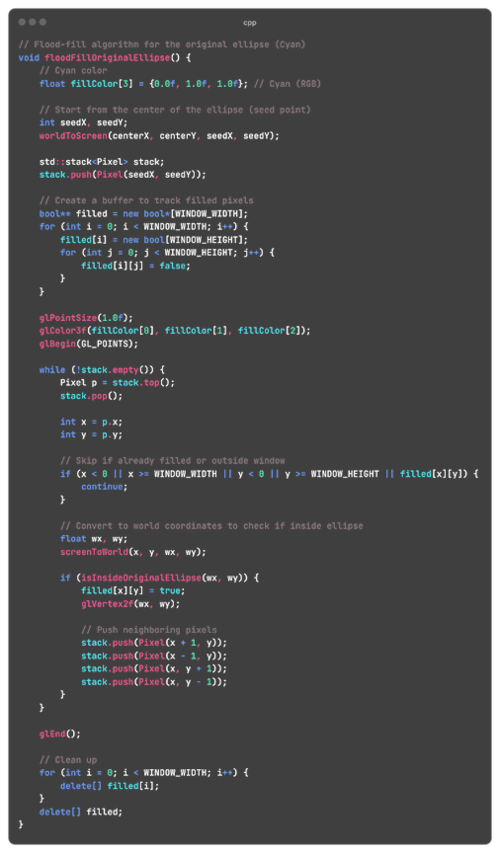
FLOOD-FILL ALGORITHM (CYAN)
Steps:
Seed point at the center (2, -1).
Use stack-based approach to fill inward.
Check pixels against ellipse equation

Slide 5
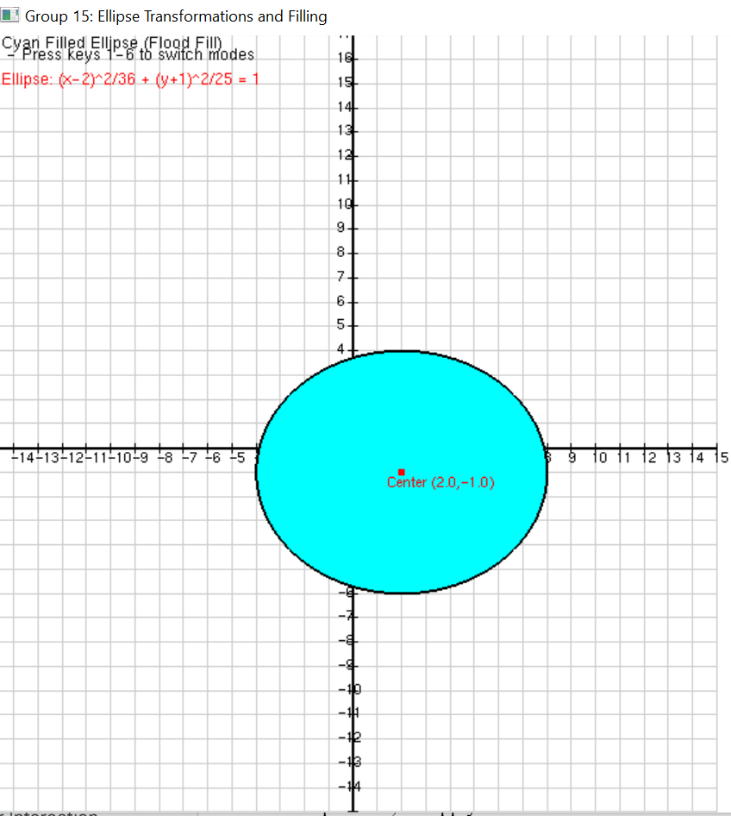
OUTPUT

Slide 6



SHEAR TRANSFORMATION
Equations
New Center:
Inverse Transformation (Key Fix):

Slide 7
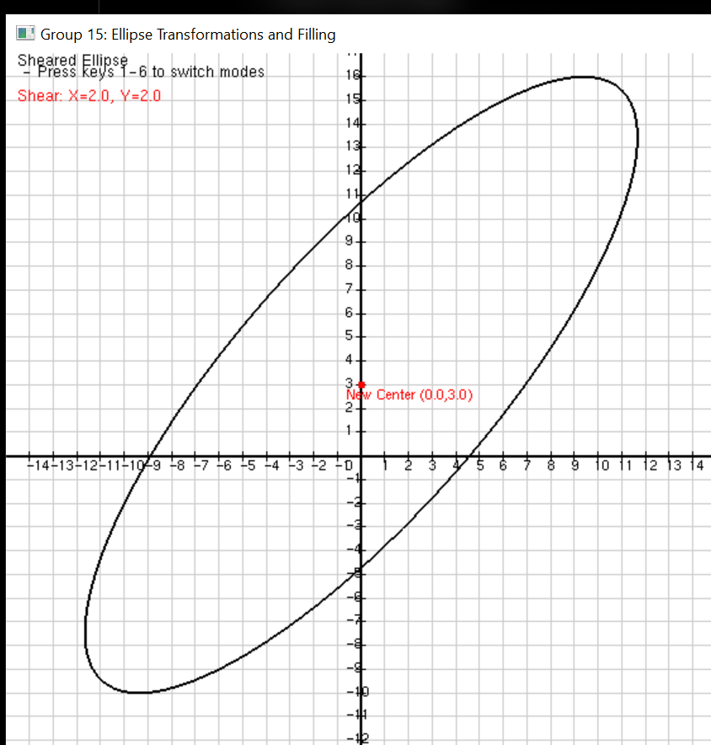
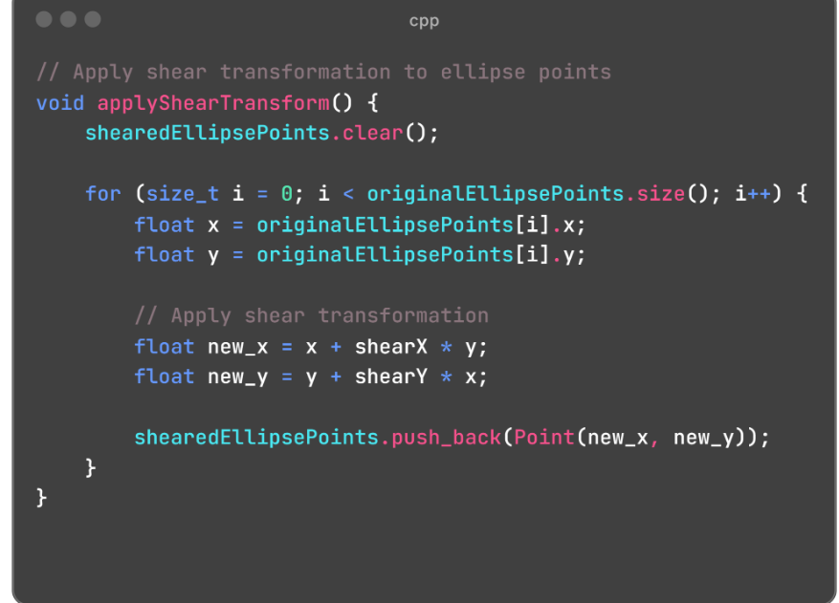
CODE AND OUTPUT

Slide 8
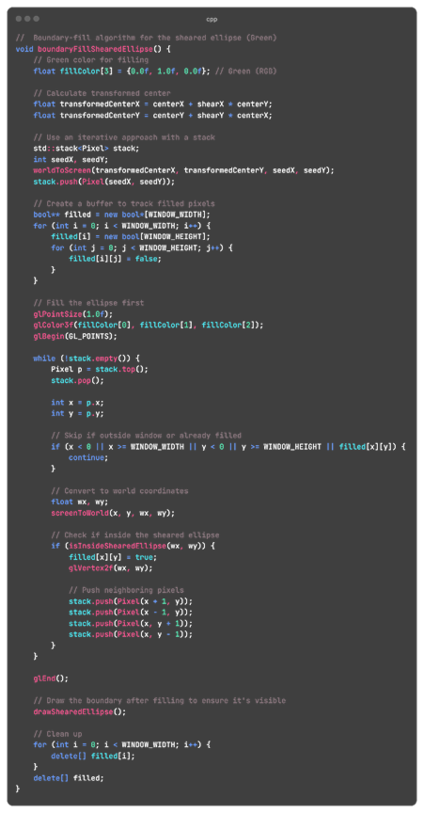

BOUNDARY FILL (GREEN)
Steps:
Seed at sheared center (0, 3).
Use inverse shear to check pixel inclusion.
Iterate until boundary is reached.

Slide 9
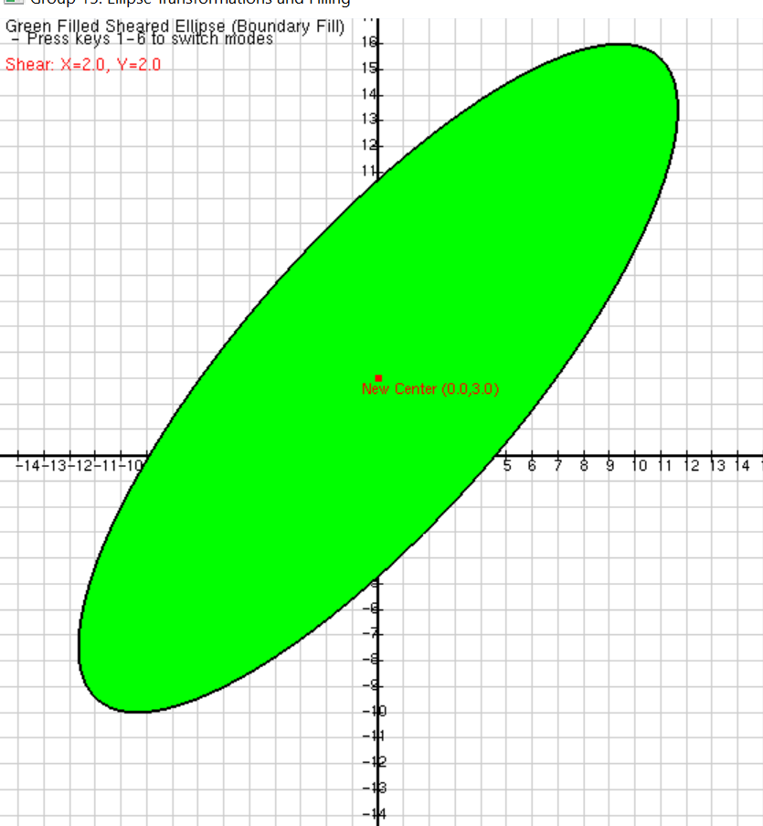
OUTPUT

Slide 10
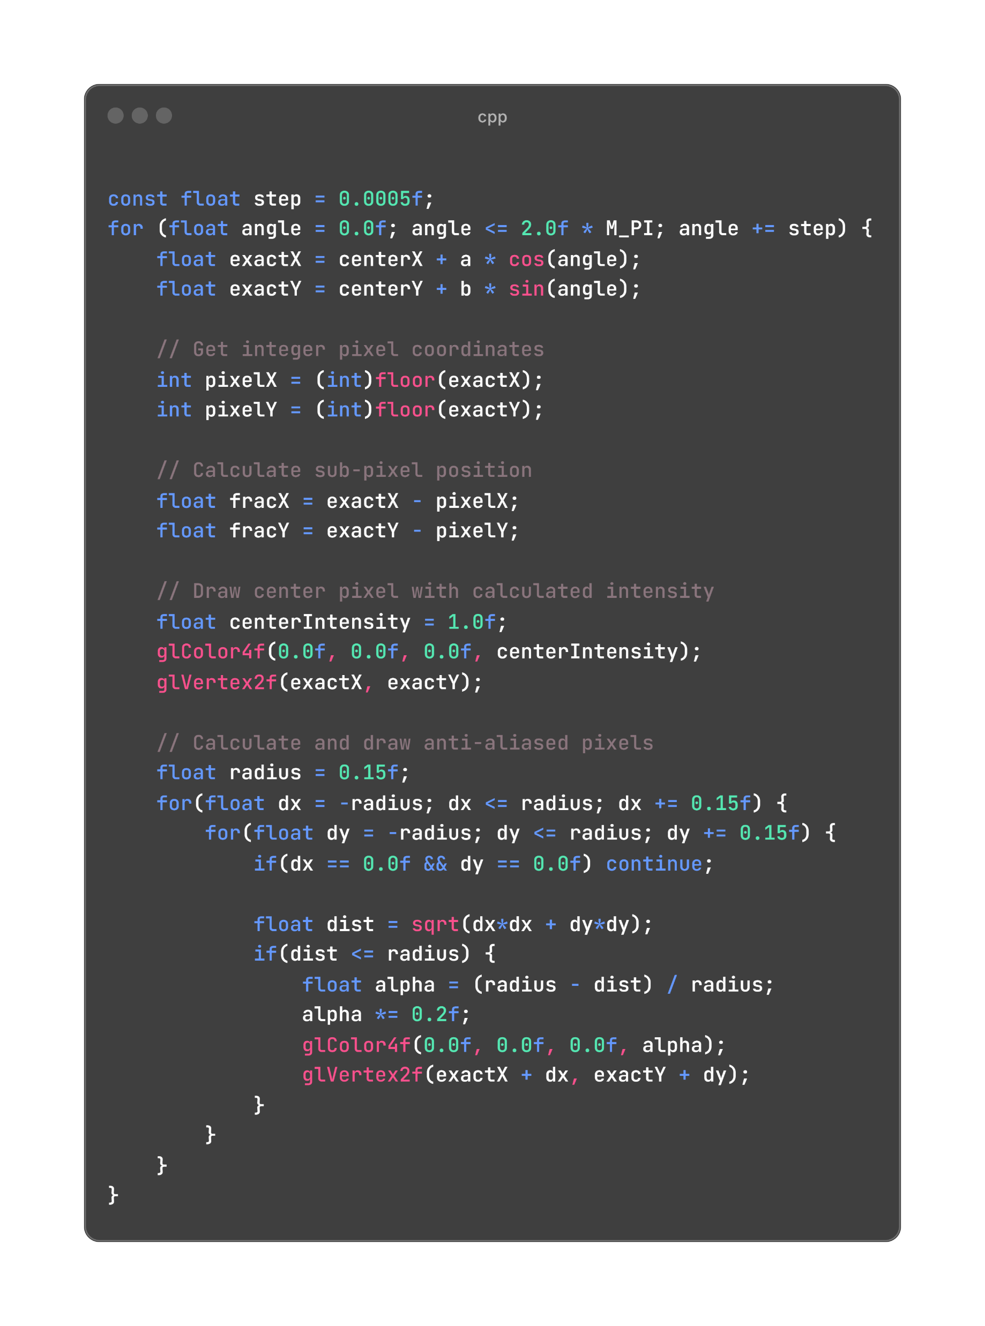
ANTI-ALIASING
Wu’s Algorithm:
Used sub-pixel rendering to calculate precise pixel intensities.
Drew neighboring pixels with varying alpha values based on distance from the exact curve.
Reduced point size and step size for a sharper, smoother appearance.

Slide 11
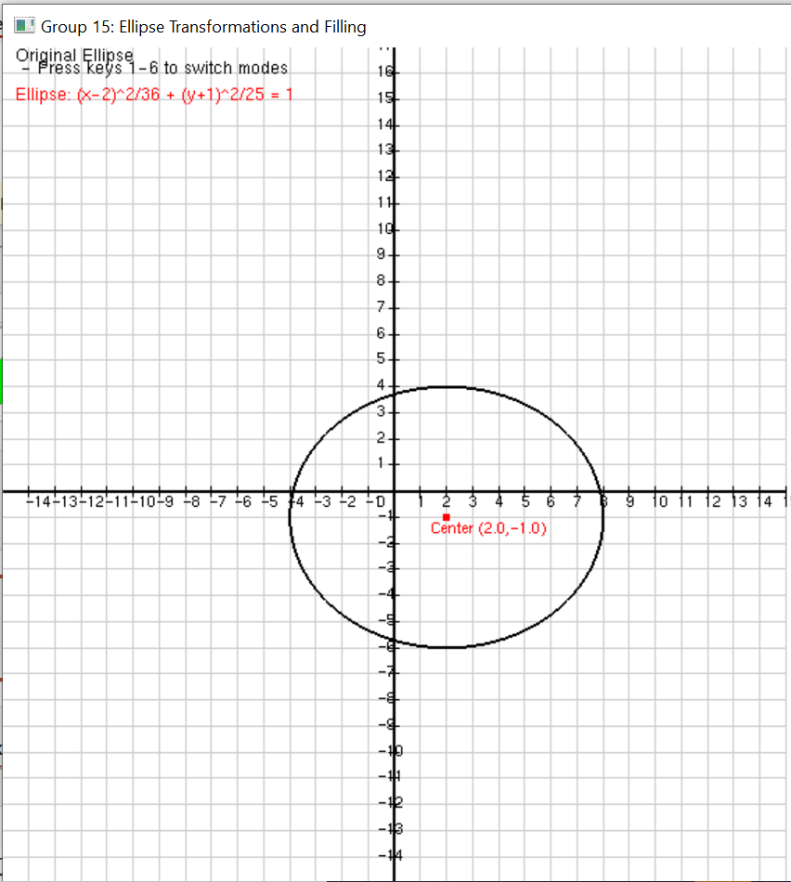
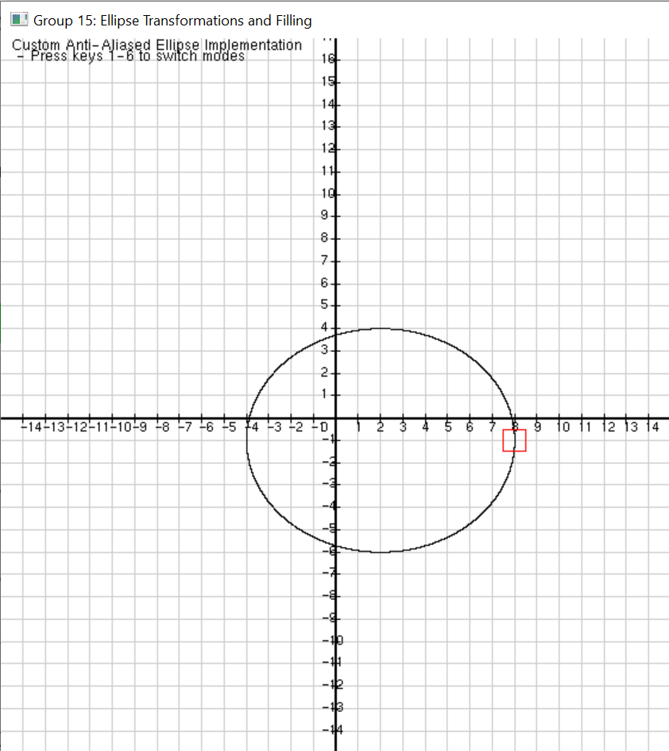
OUTPUT
AFTER
BEFORE

Slide 12
Thank You
For your attention

